Slide 1
Batch JJ

Slide 2
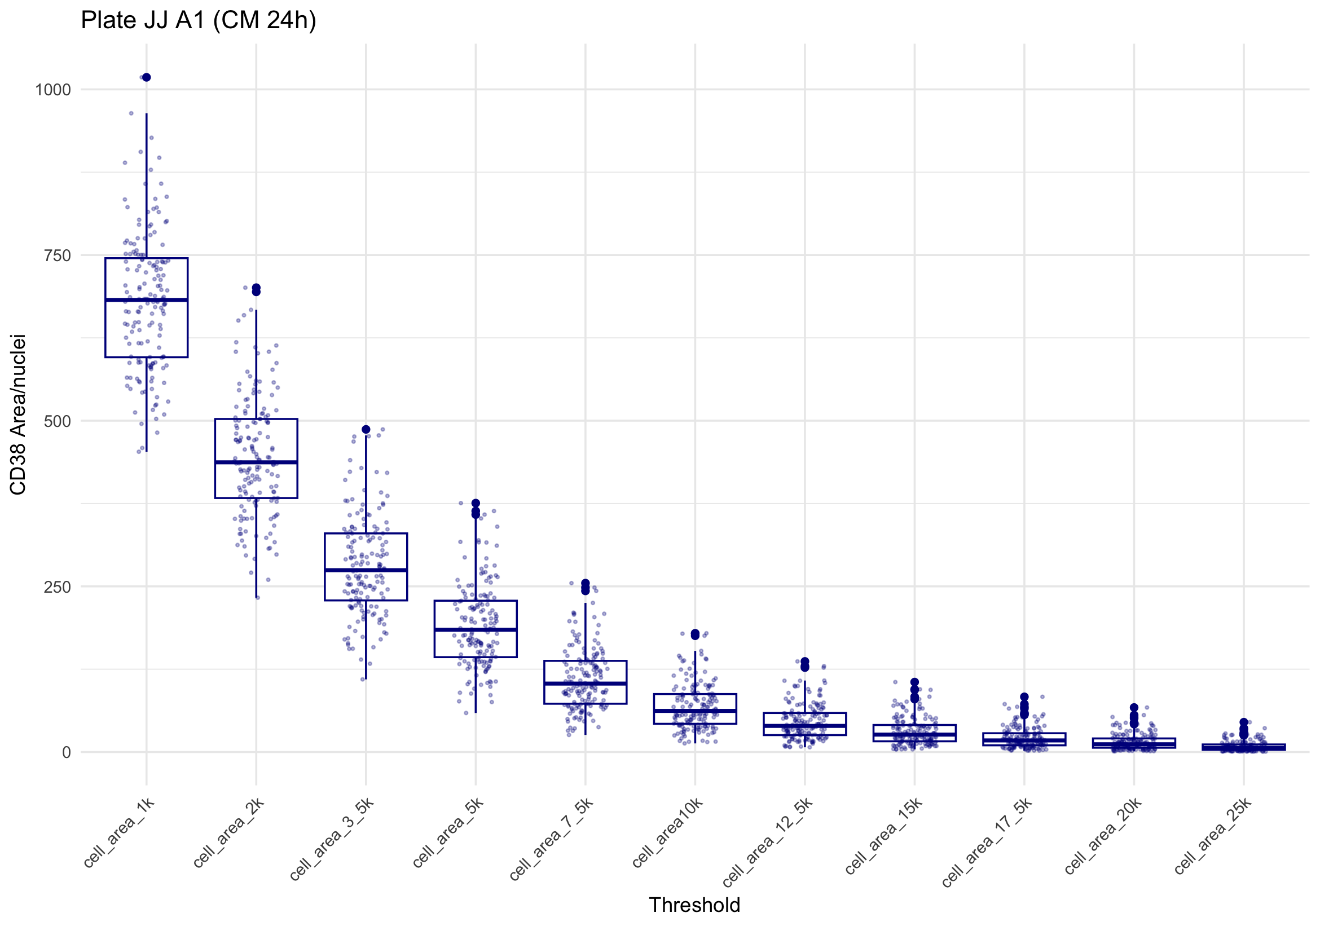
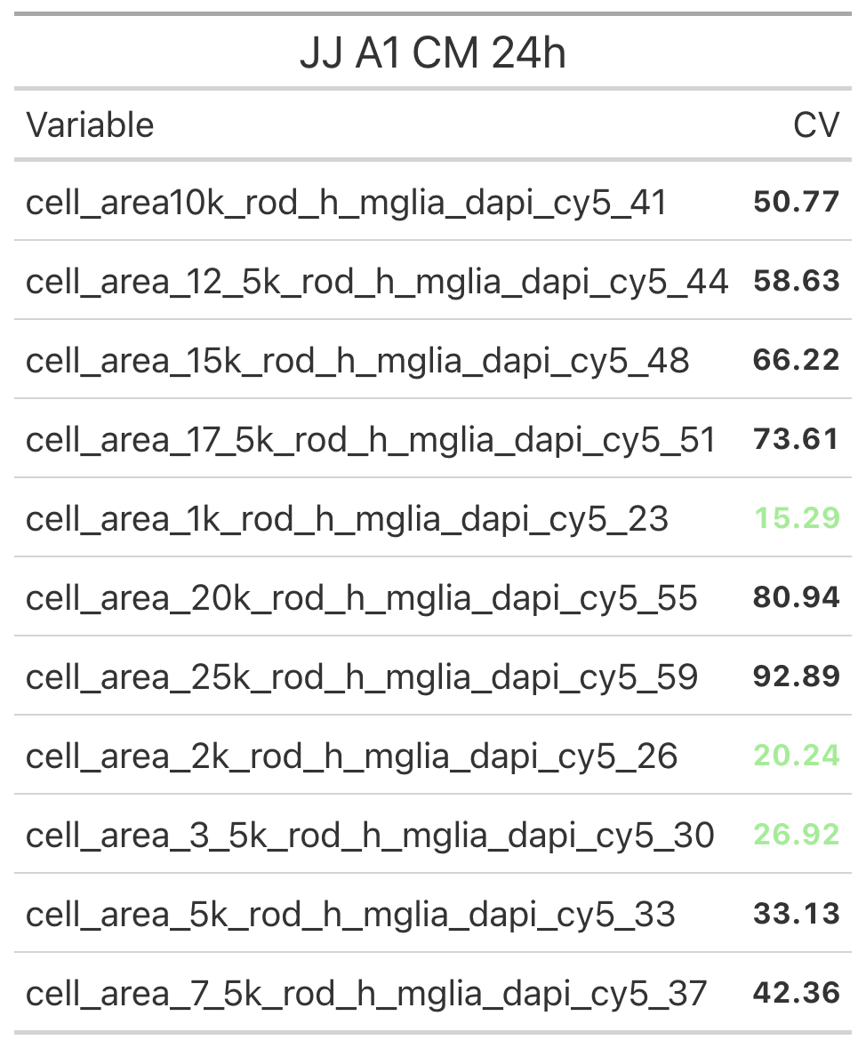
A1: All thresholds in Conditioned Media (with edges)
Microglia inflammatory activity = area of fluorescence intensity per nuclei count
(CV based on max. signal)
Notes:
Graph includes all conditions. CV only max signal (dmso/LPS)

Slide 3
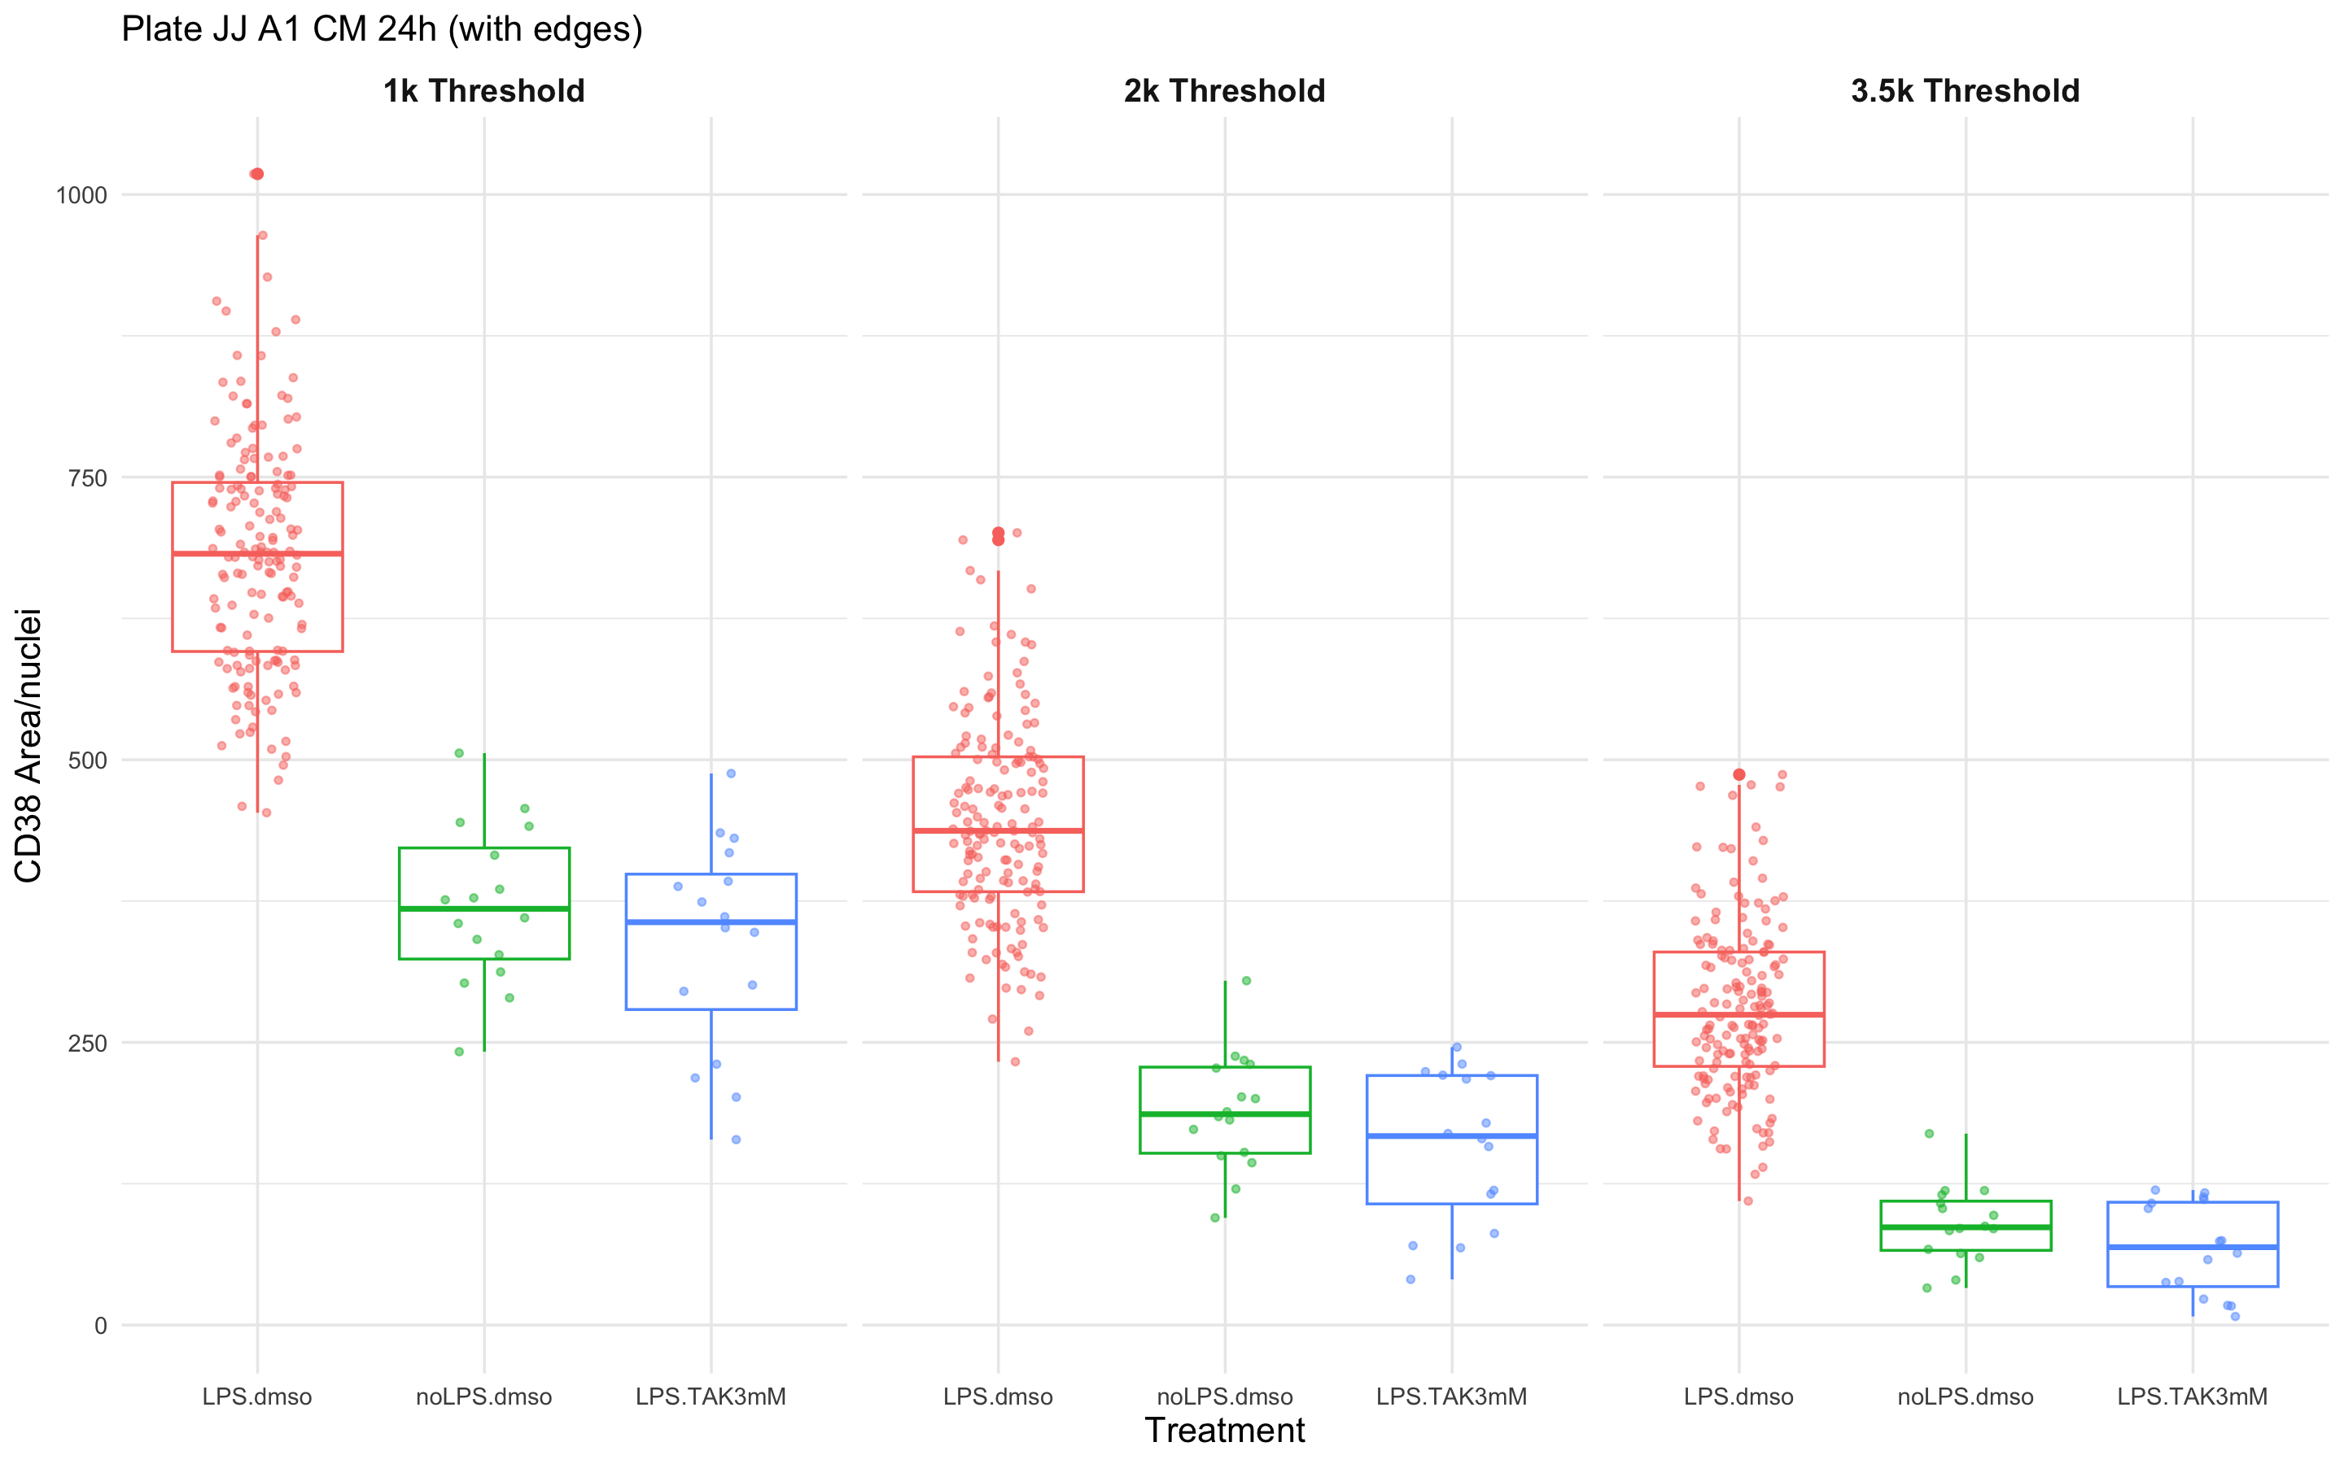
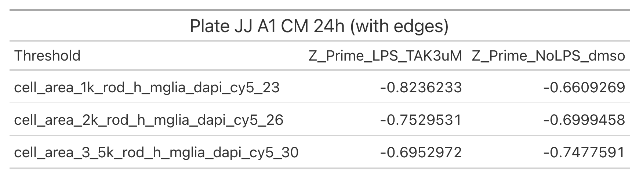
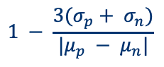
A1: Control Data (with edges)
Z’: Quantifying the quality of our screening assay
$$1 − \frac{3(σ_{p}+ σ_{n})}{|μ_{p} − μ_{n}|}$$
Zhang et al., 1999
Notes:
Make colour blind friendly

Slide 4
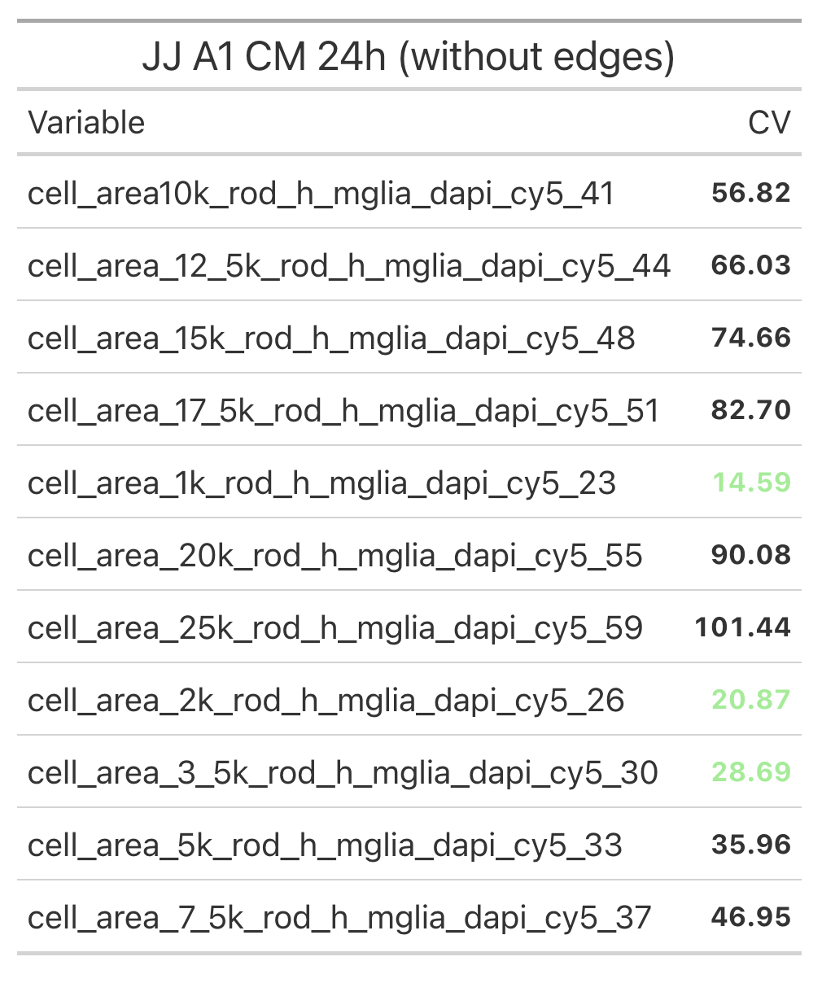
A1: Comparing CV’s
with edges
without edges

Slide 5
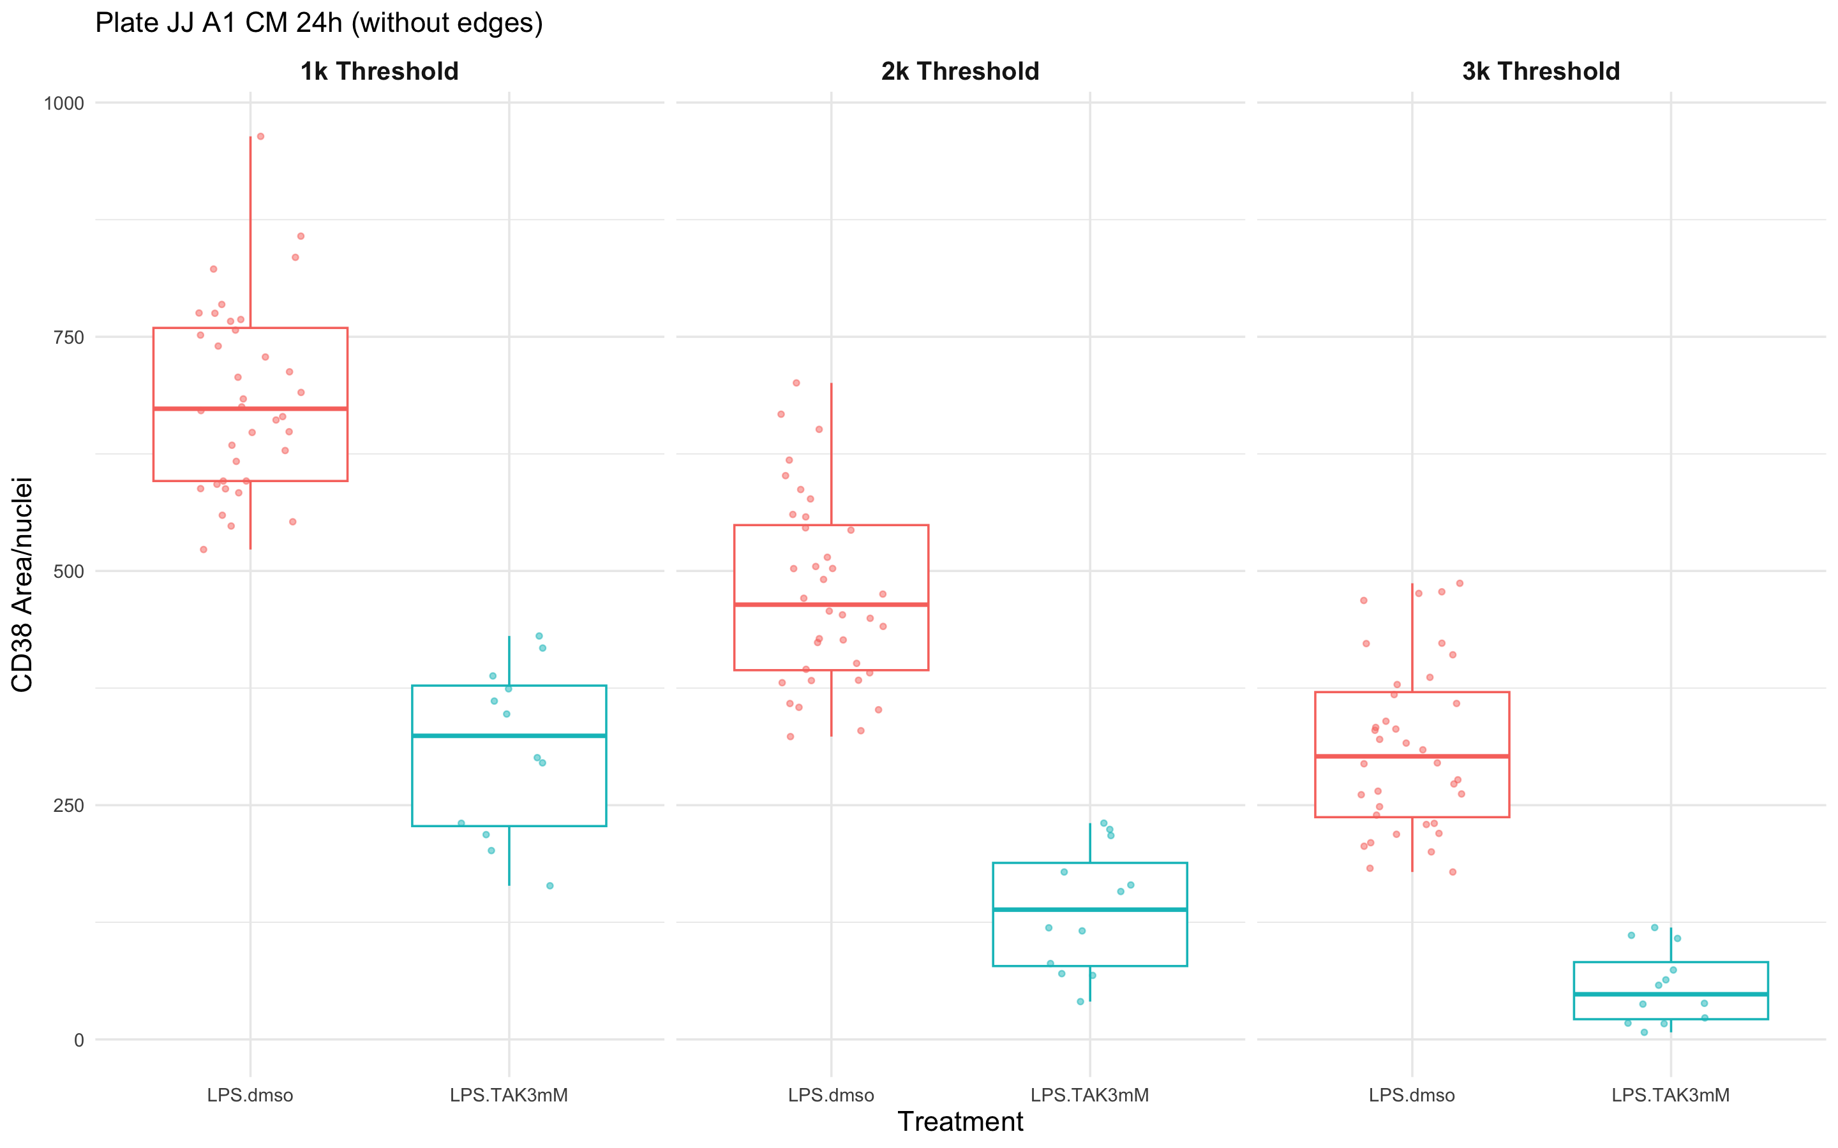
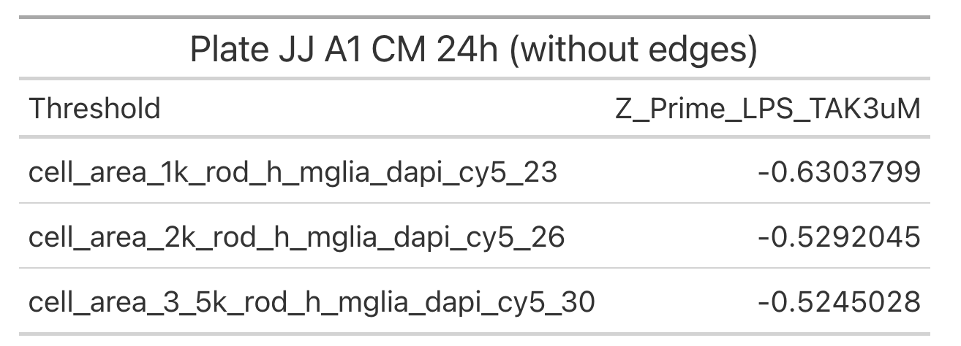
A1: Control Data (without edges)

Slide 6
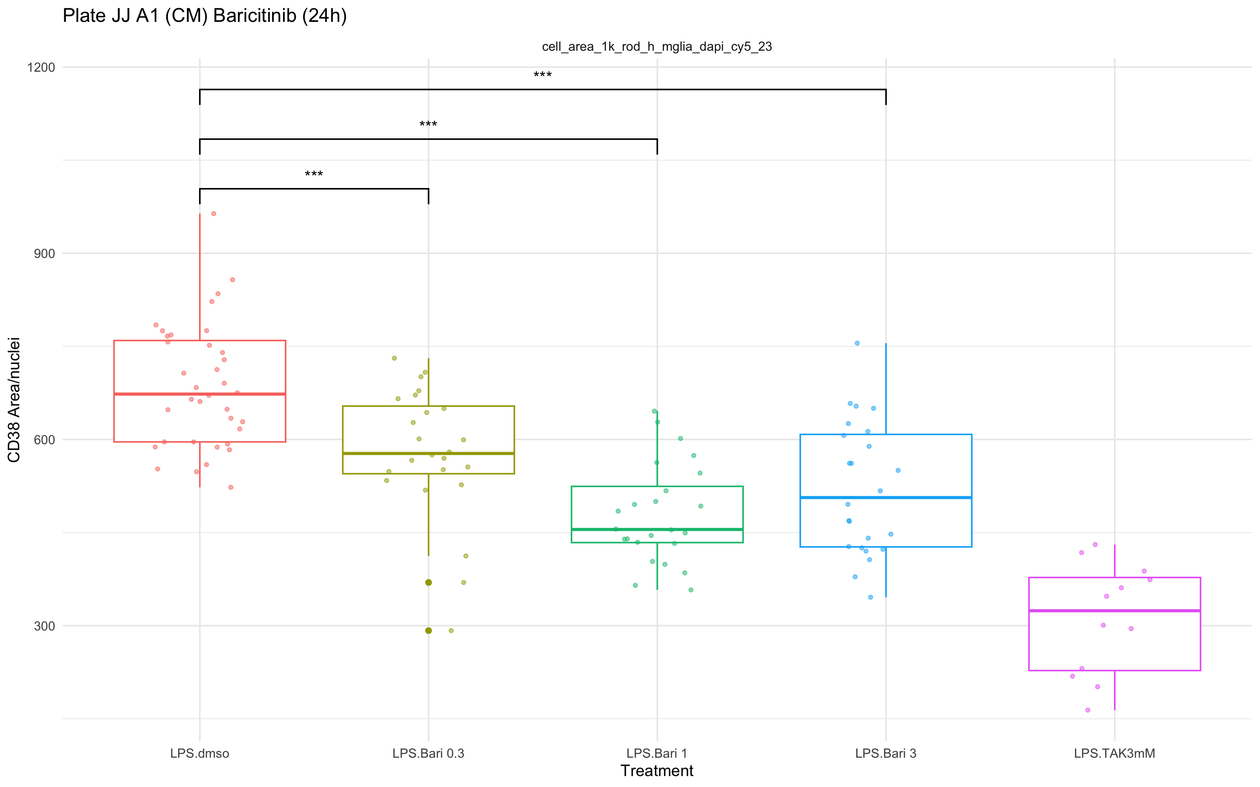
A1: Compound Data - Baricitinib
1K Threshold
(without edges)
Notes:
Performed 1 way anova after ensuring assumptions met.

Slide 7
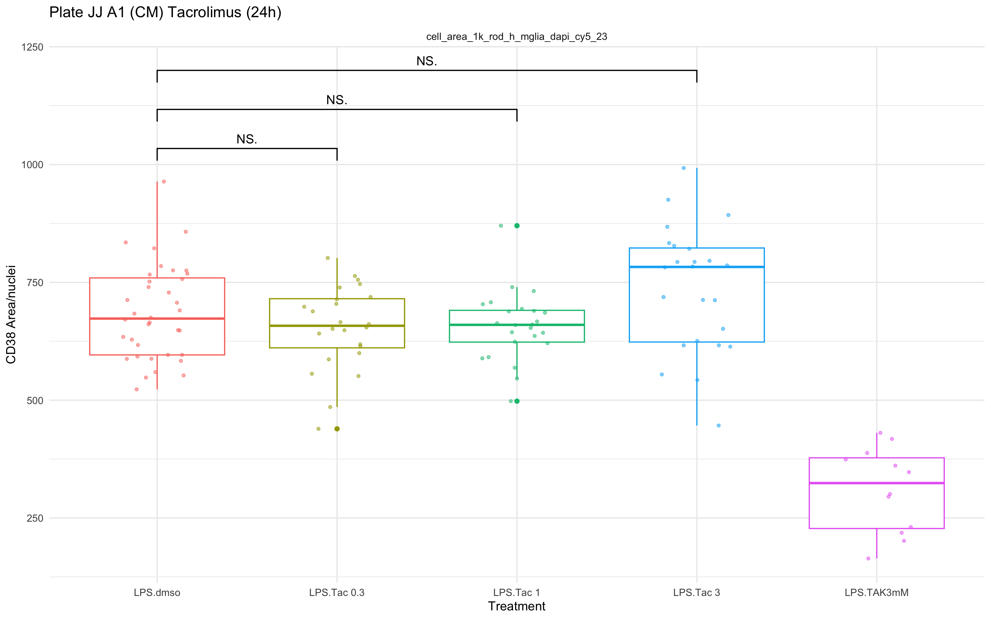
A1: Compound Data - Tacrolimus
1K Threshold
(without edges)
Notes:
Perform 1 way anova

Slide 8
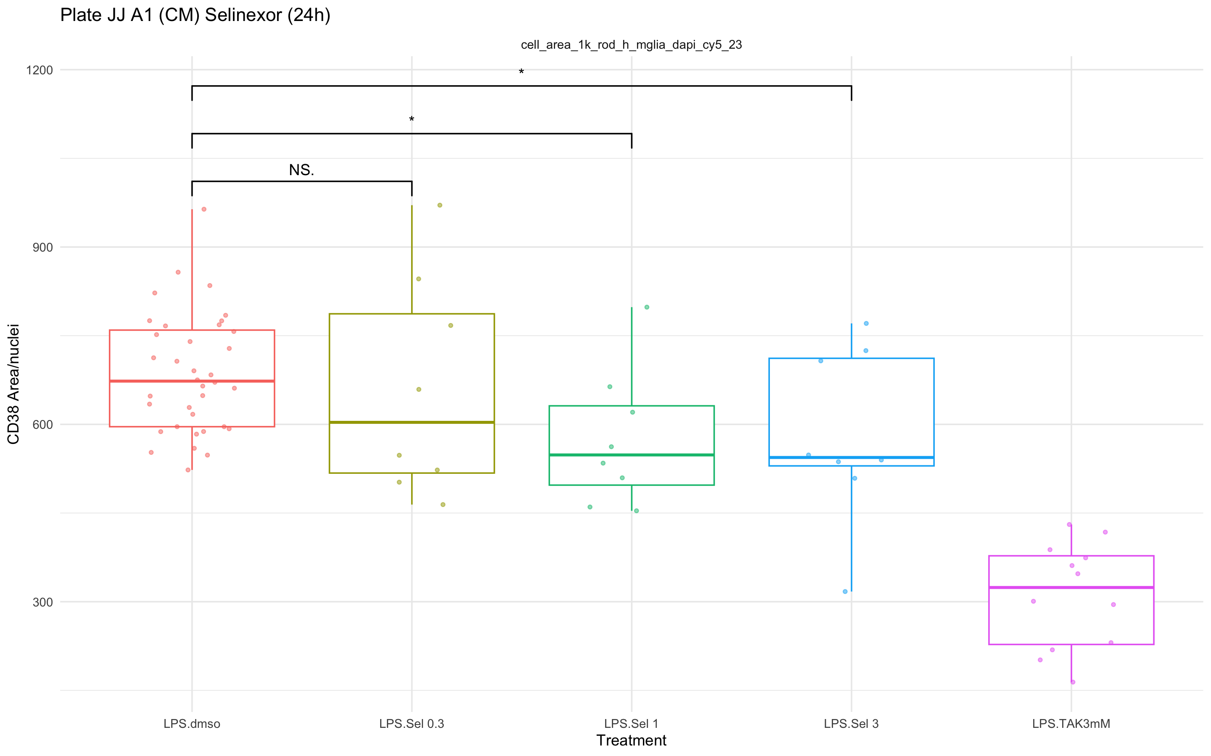
A1: Compound Data - Selinexor
1K Threshold
(without edges)
Notes:
Perform 1 way anova

Slide 9
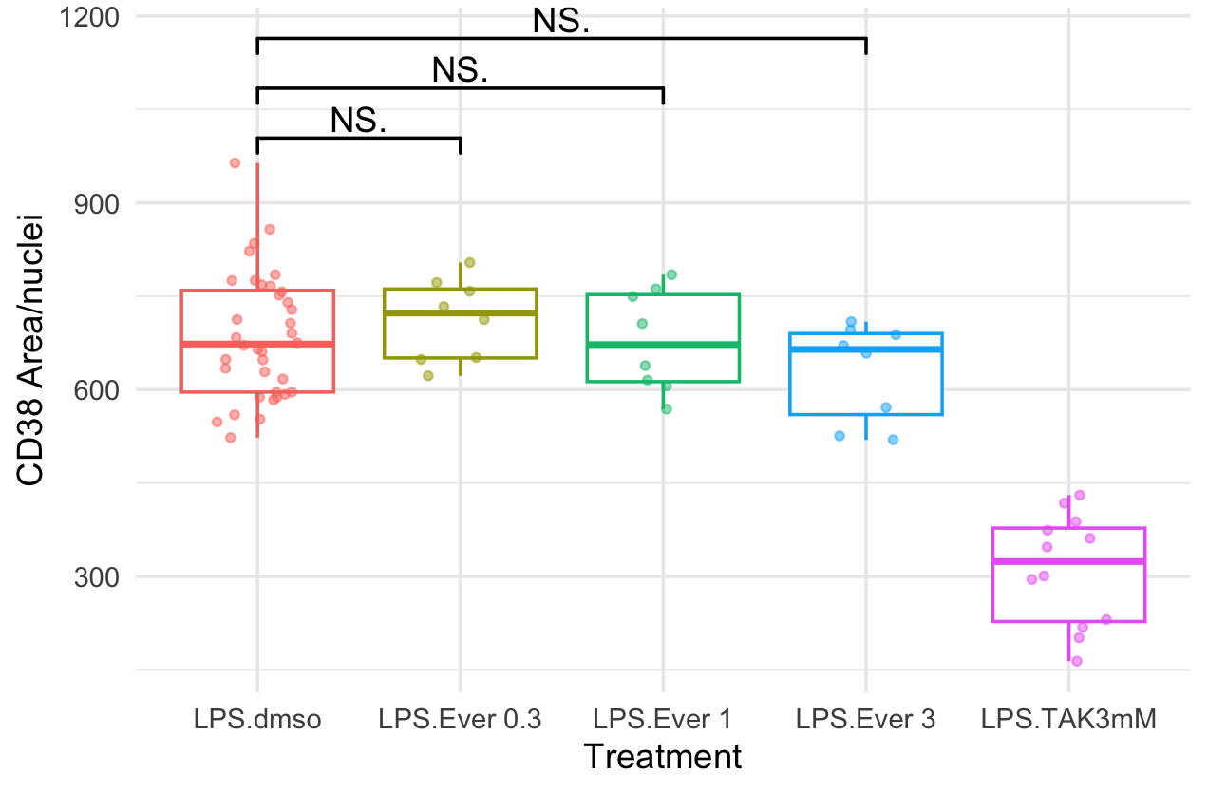
A1: Compound Data - Everolimus
1K Threshold
(without edges)
Notes:
Perform 1 way anova

Slide 10
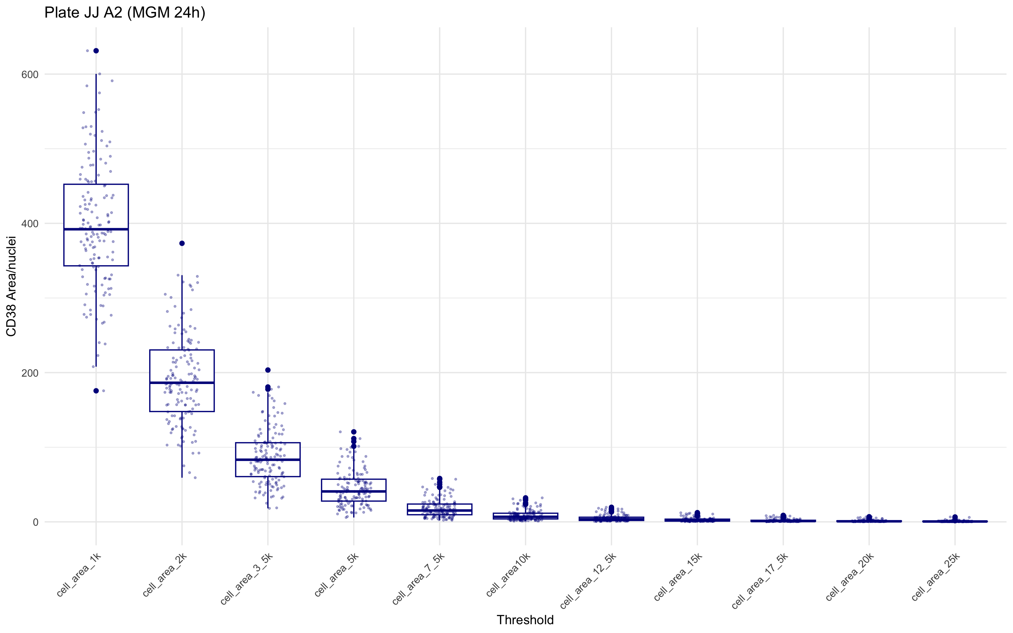
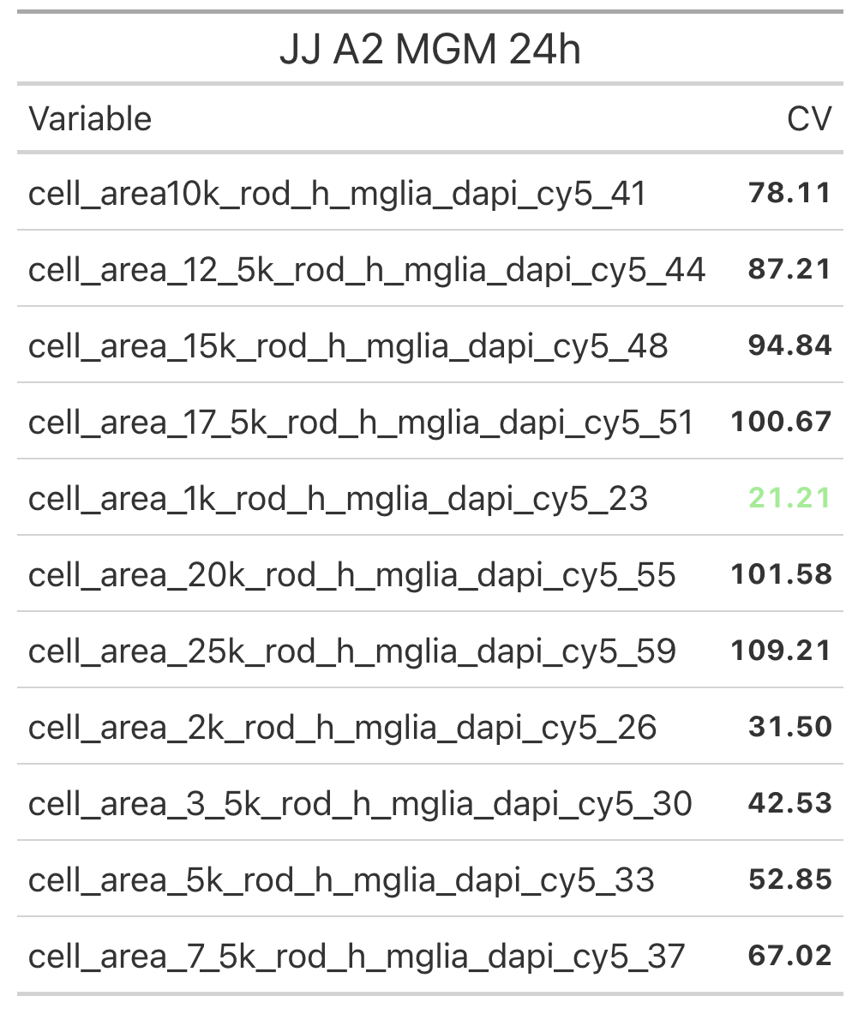
A2: All thresholds in Defined Media (MGM)
Notes:
Change graph

Slide 11
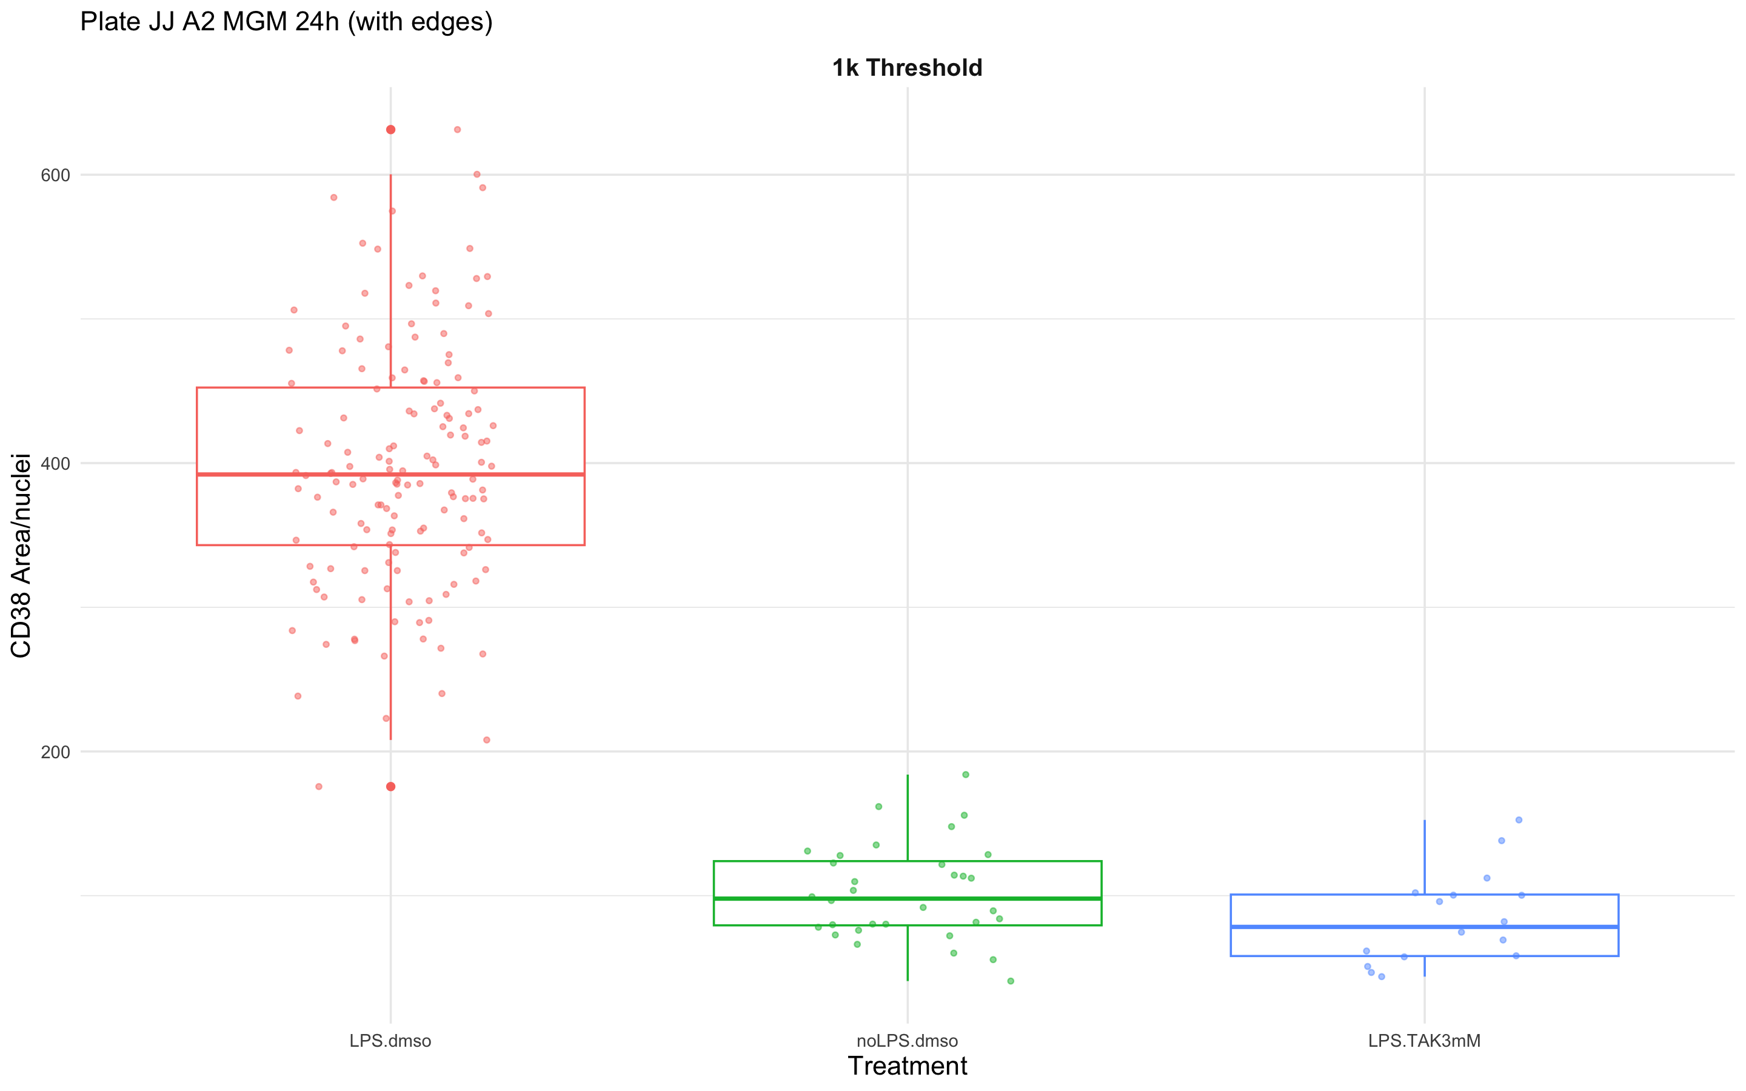
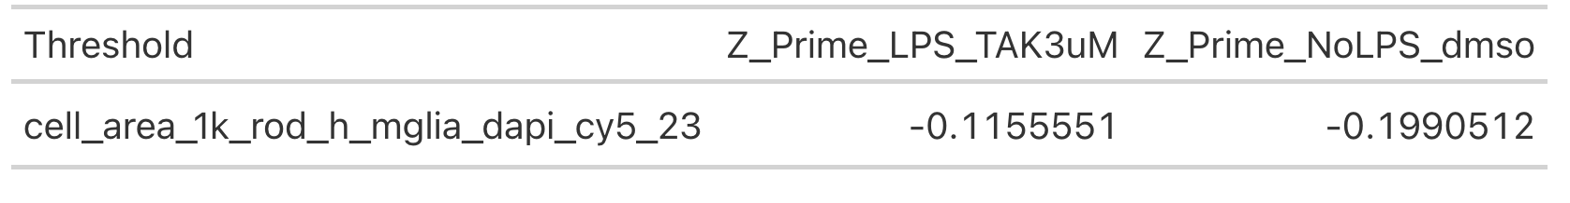
A2: Control Data (with edges)

Slide 12
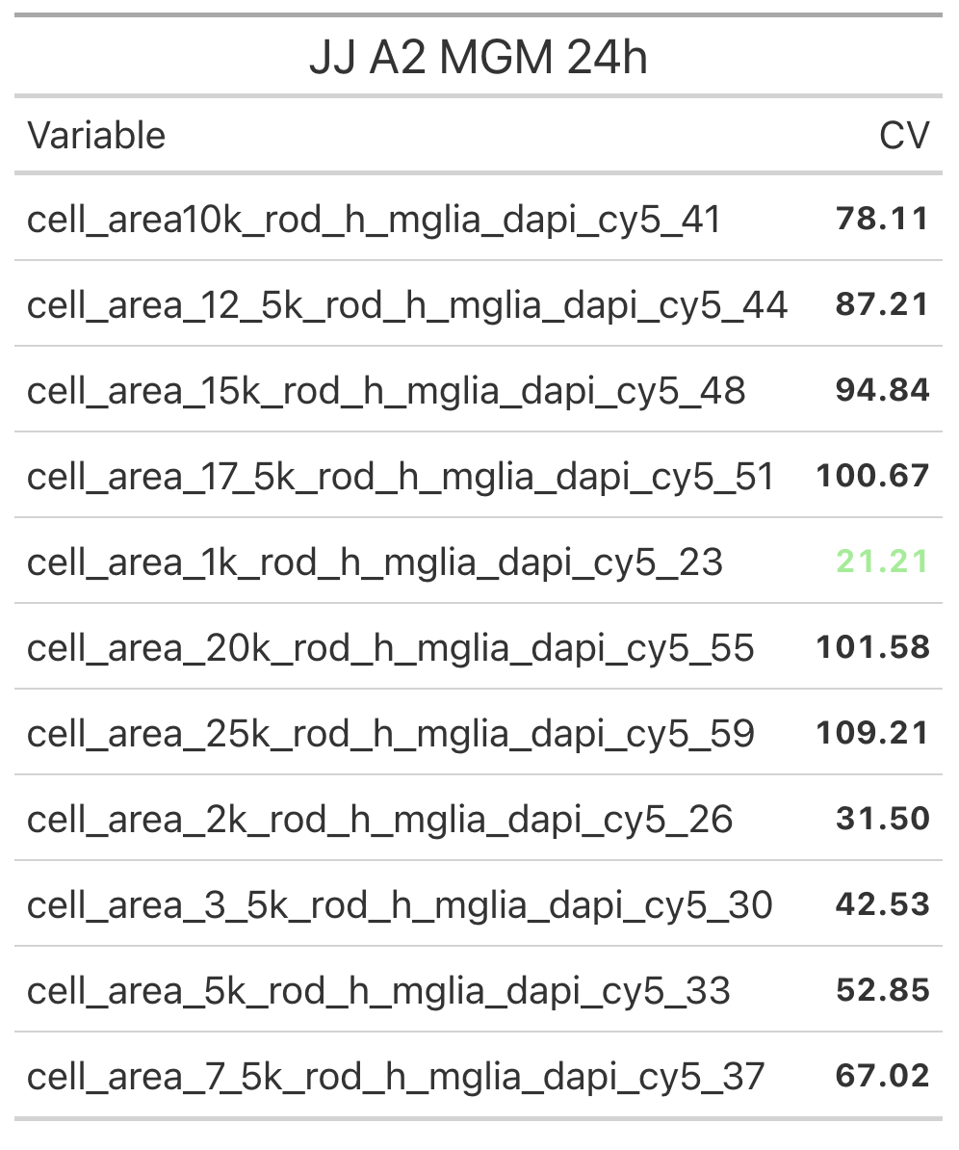
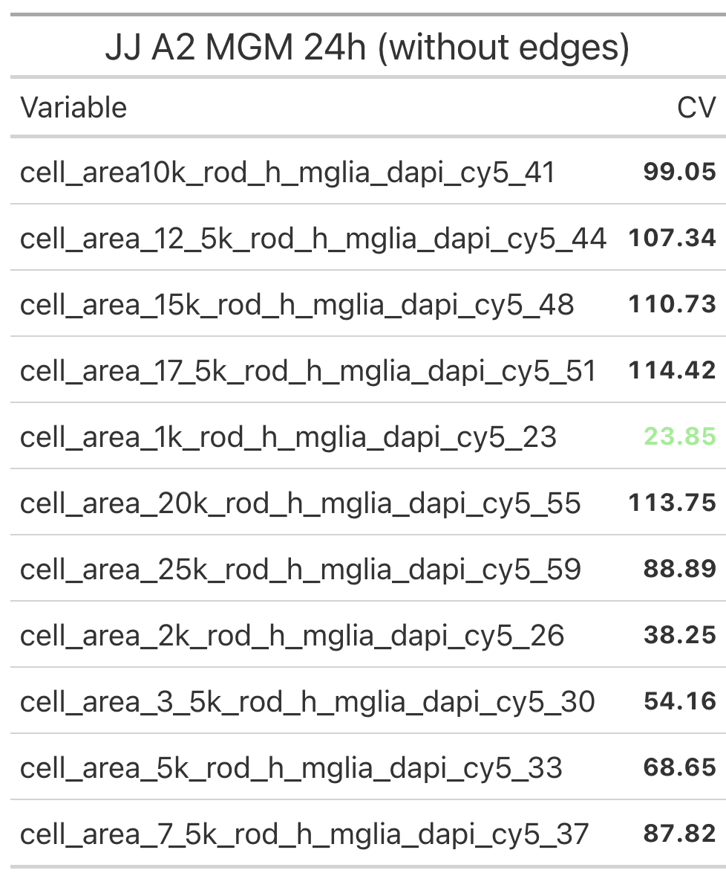
A2: Comparing CV’s
with edges
without edges

Slide 13
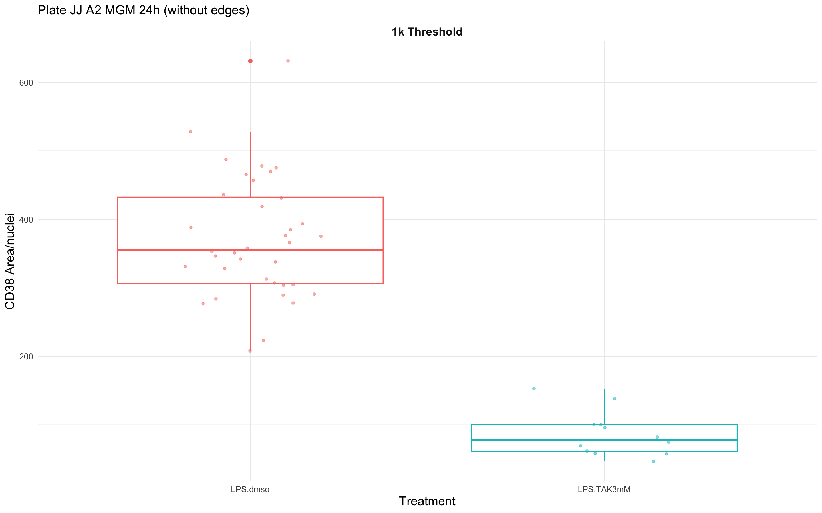
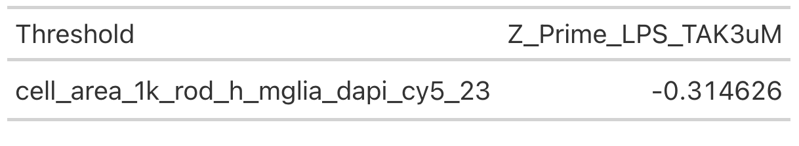
A2: Control Data (without edges)

Slide 14
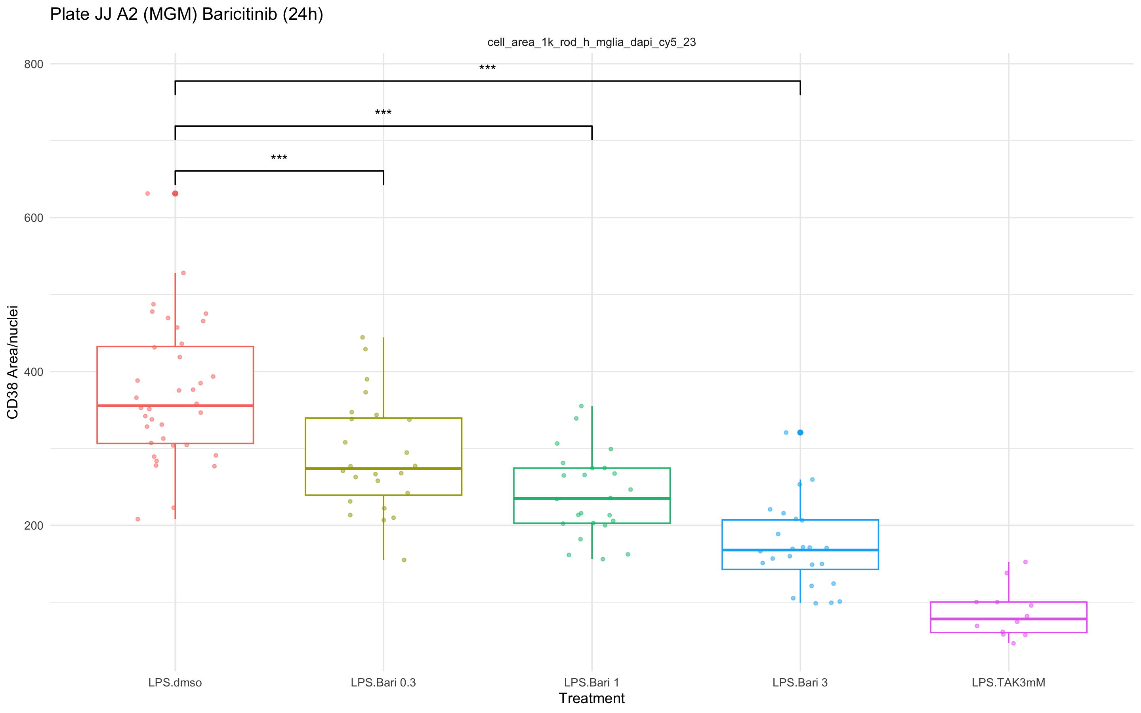
A2: Compound Data - Baricitinib
1K Threshold
(without edges)

Slide 15
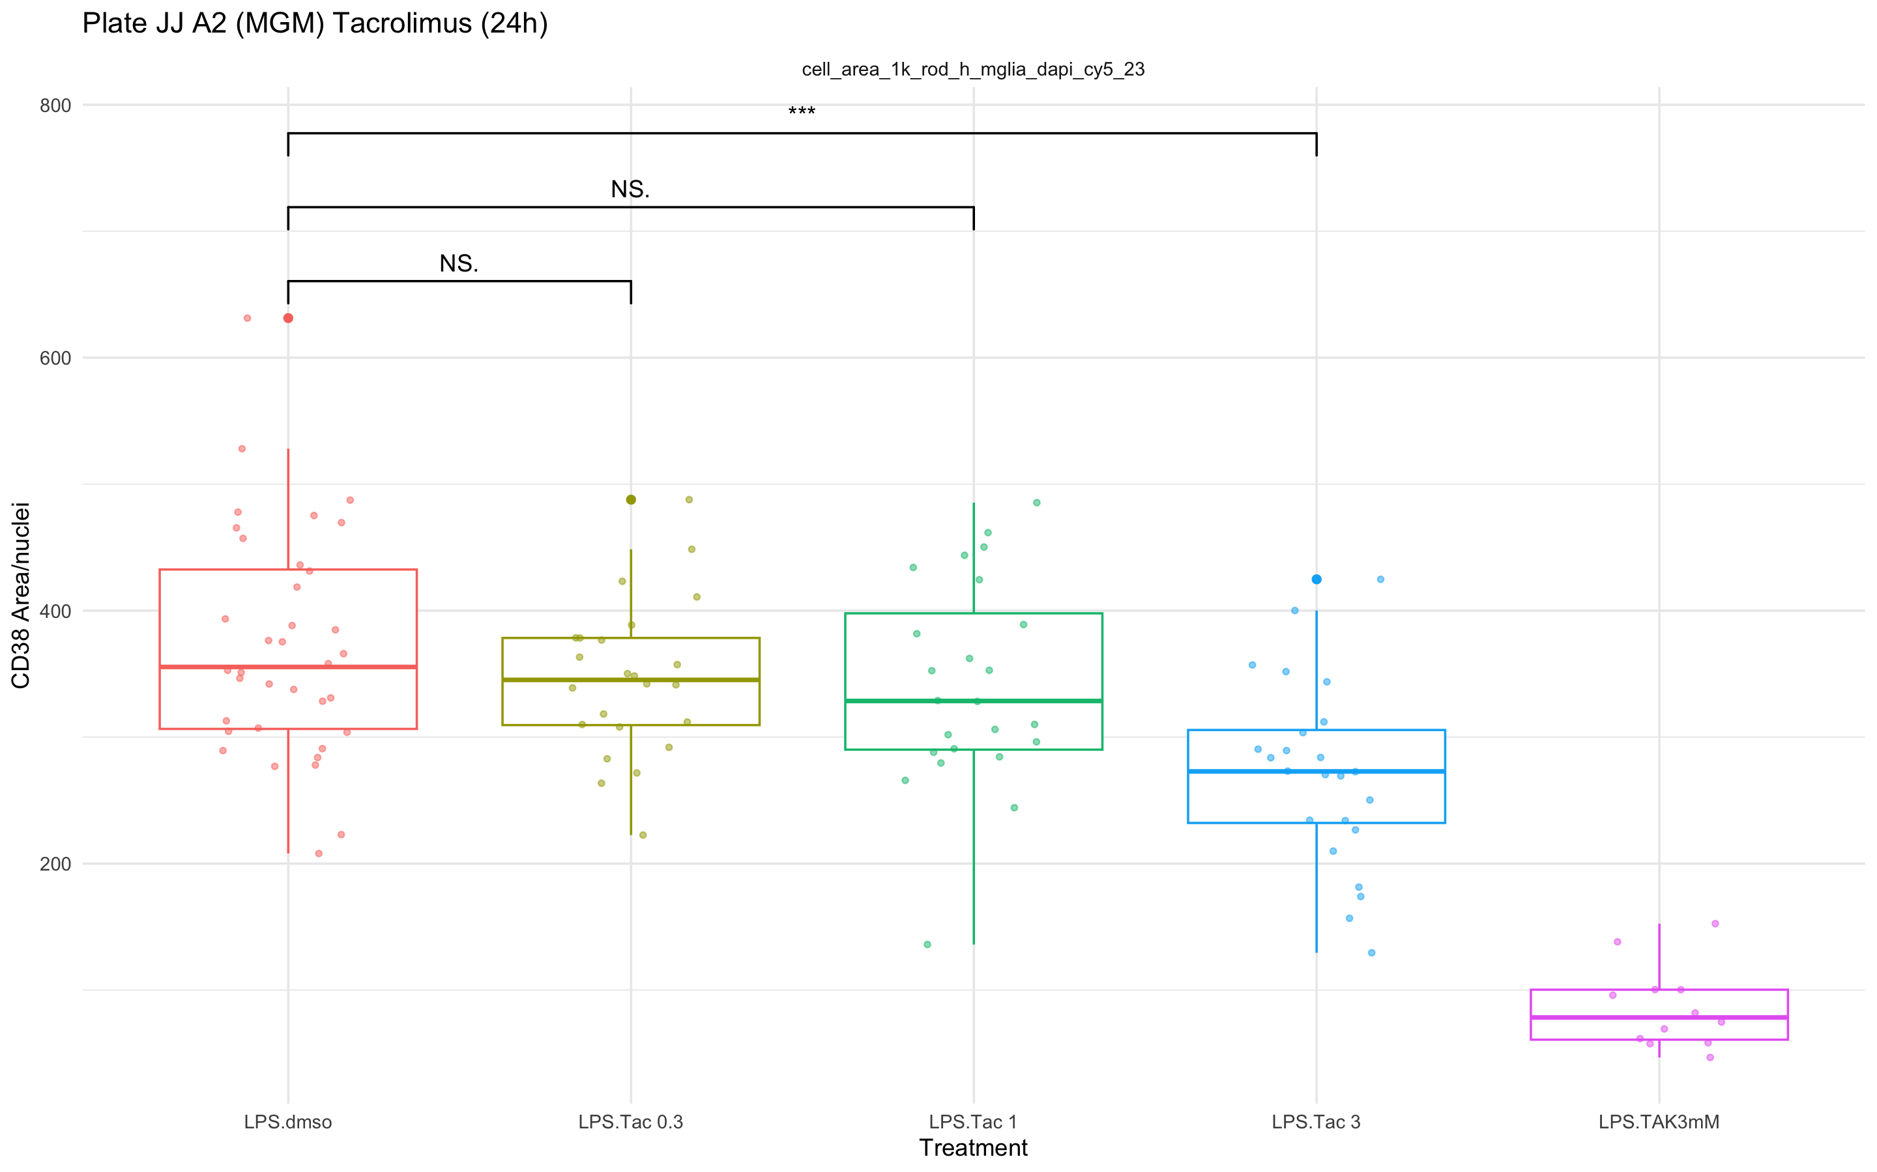
A2: Compound Data - Tacrolimus
1K Threshold
(without edges)

Slide 16
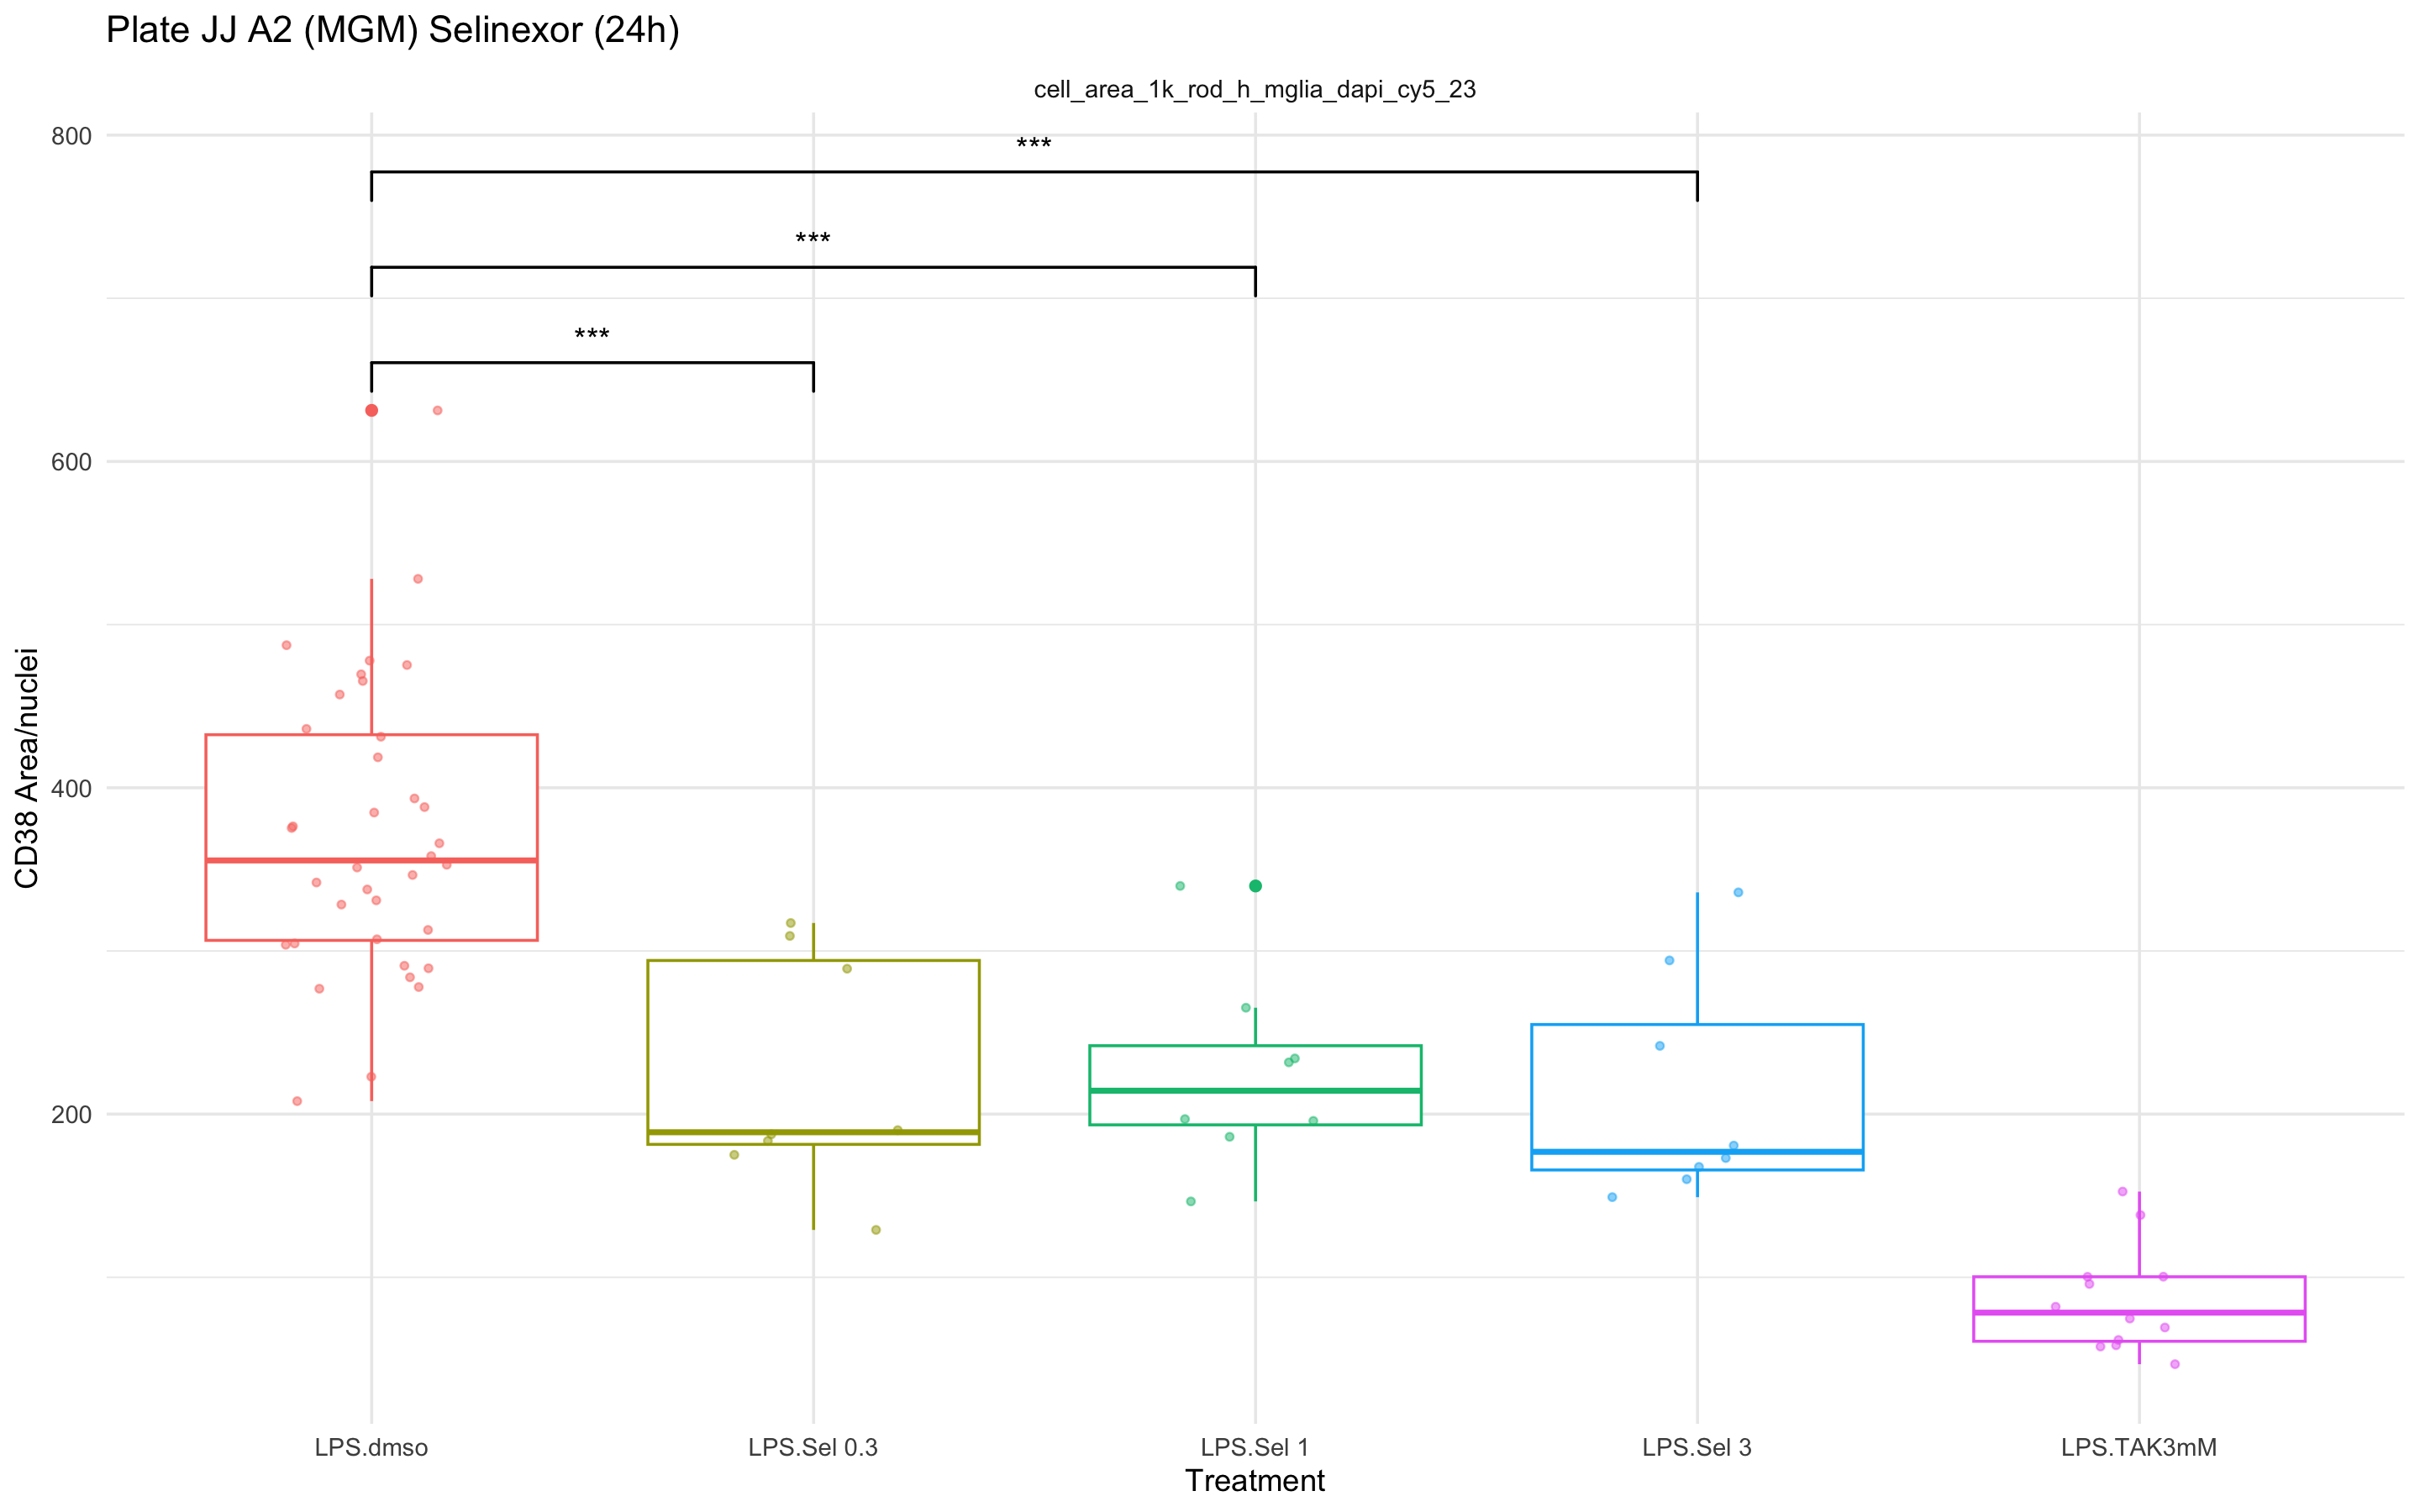
A2: Compound Data - Selinexor
1K Threshold
(without edges)

Slide 17
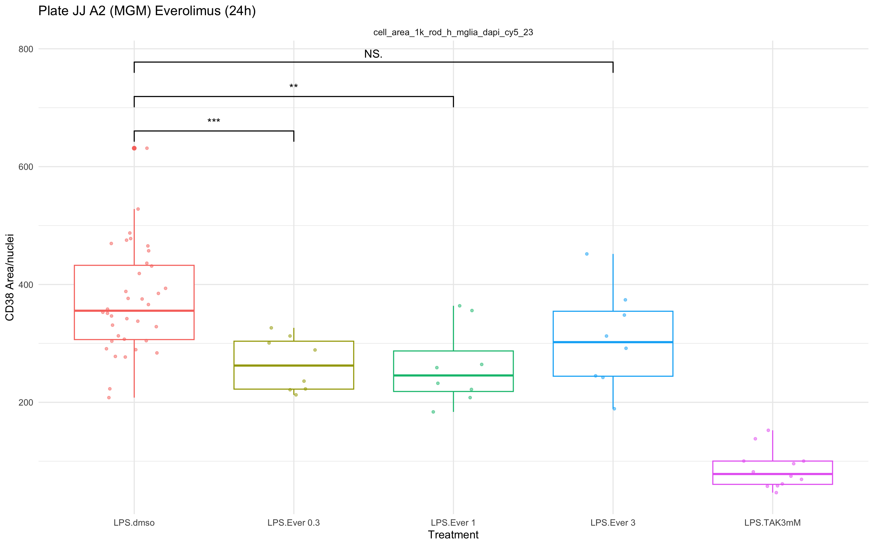
A2: Compound Data - Everolimus
1K Threshold
(without edges)

Slide 24
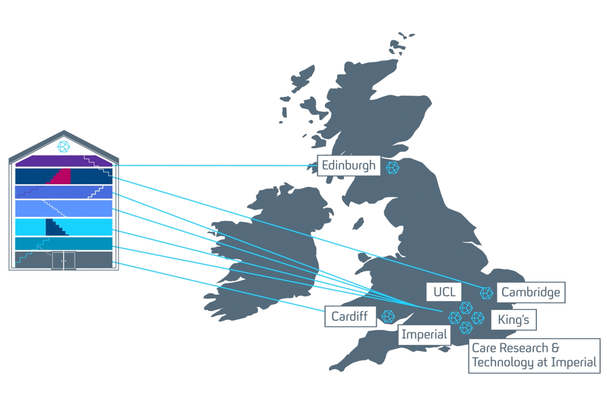
Main header / Question / Conclusion (Arial – 28 – navy)
Short example sentences which can be highlighted in bold or highlight colours. (Arial – 18 – navy)
Sample bullet point title (Arial – 18 – navy)
Bullet points are ‘sky blue’ and this can be customised under ‘Bullet points and numbering’
Sample bullet point 2 (Arial– 16 – navy)
Sample bullet point 1 (Arial – 16 – navy)

Slide 25

Thank you for listening
Name Position Contact email or Slack details
Name Position / Role
Name Position / Role
Name Position / Role
Name Position / Role
Collaborator institution Name (Position / Role) Name (Position / Role) Name (Position / Role)
Collaborator project Name (Institution) Name (Institution Name (Institution

